Slide 1
حقوق مالكيت فكري
حقوقي است كه از طرف جامعه به اشخاص حقيقي يا حقوقي به خاطر خلق آثار ادبي و معنوي ،اختراعات ،طرح ها و اسامي و نشان هاي استفاده شده در تجارت داده مي شود،اين حقوق به دارنده اختيار مي دهد كه ديگران را از استفاده غير مجاز از حق خود در طول دوره محدودي منع نمايد .

Slide 2
What is Intellectual Property? Intellectual property (IP) refers to creations of the mind: inventions, literary and artistic works, and symbols, names, images, and designs used in commerce.

Slide 3
IP is divided into two categories:
Copyright,
Industrial property,
Includes:
literary and artistic works such as novels, poems and plays, films, musical works, artistic works such as drawings, paintings, photographs and sculptures, and architectural designs.
includes inventions (patents),
trademarks,
industrial designs,
and geographic indications of source;

Slide 4
مالکیت ادبی وهنری
آثار نوشتاری
آثار تجسمی
آثار سمعی وبصری

Slide 5
literary and artistic works : novels . poem

Slide 6
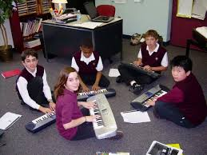
plays, films, musical works,

Slide 7
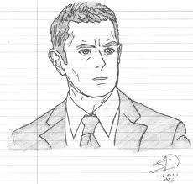
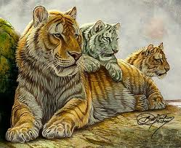
artistic works such as drawings, paintings

Slide 8
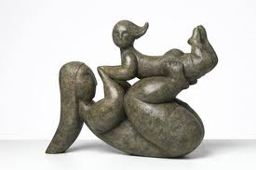
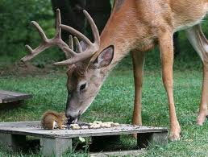
photographs and sculptures

Slide 9
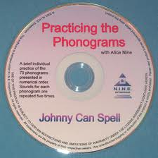
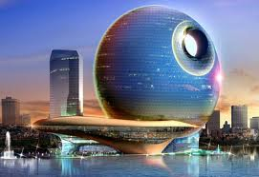
producers of phonograms :architectural designs

Slide 10
trademark:Industrial property

Slide 11
علامت تجاری چیست؟
علامت تجاری نشانی است که قادر است کالاهای تولیدی یا خدمات ارائه شده توسط یک شخص/بنگاه را از کالاها یا خدمات سایر بنگاه‌ها با اشخاص متمایز نماید.
طبق ماده 30 قانون علامت‌، علامت جمعي و نام تجاري عبارتند از:
الف ـ علامت يعني هر نشان قابل رؤيتي كه بتواند كالاها يا خدمات اشخاص حقيقي يا حقوقي را از هم متمايز سازد.
ب ـ علامت جمعي يعني هر نشان قابل رؤيتي كه باعنوان علامت جمعي در اظهارنامه ثبت معرفي شود و بتواند مبدأ و يا هرگونه خصوصيات ديگر مانند كيفيت كالا ياخدمات اشخاص حقيقي و حقوقي را كه از اين نشان تحت نظارت مالك علامت ثبت شده جمعي استفاده مي‌كنند متمايز سازد.
ج ـ نام تجارتي يعني اسم يا عنواني كه معرف و مشخص‌كننده شخص حقيقي ياحقوقي باشد.

Slide 12
مزایای ثبت علائم تجاری
· تضمین می‌کند که مشتریان می‌توانند محصولات را از یکدیگر تشخیص دهند.
شرکت‌ها را قادر می‌سازد محصولات‌شان را از یکدیگر متمایز سازند.
ابزار بازاریابی و اساس ایجاد وجهه و شهرت شرکت‌ها هستند.
اجازه استفاده از آنها به اشخاص ثالث داده می‌شود و منبع مستقیم درآمد از محل حق امتیازها می‌باشند.
جزء ضروری موافقت‌نامه‌های اعطای نمایندگی هستند.
ممکن است دارائی ازرشمند کسب و کار باشند
شرکت‌ها را تشویق می‌کنند در حفظ یا بهبود کیفیت محصولات سرمایه‌گذاری کنند.
ممکن است برای دریافت وام مفید باشند.

Slide 13
طرحهای صنعتی
چه طرح هایی بعنوان طرح صنعتی قابل ثبت است؟
· طرح باید "جدید" باشد یک طرح در صورتی جدید محسوب خواهد شد که عین آن قبل از تاریخ تسلیم یا تقاضانامه ثبت در دسترس عموم نباشد.
· طرح باید "اصیل" اصل باشد. یک طرح در صورتی اصل محسوب می شود که بطور مستقل توسط طراح پدیده آمده باشد و کپی یا تقلیدی از طرح های موجود نباشد.
· طرح باید شخصیت فردی داشته باشد. یعنی تأثیر کلی که طرح بر کاربر آگاه بوجود می آورد با تأثیر کلی که طرح های قبلی که قبلاً در دسترس عموم قرار گرفته اید بر آن کاربر بوجود می آورند، تفاوت داشته باشد.

Slide 14
نمونه طرح صنعتی

Slide 15
BEFORE DRAFTING
What is the invention ?
Is invention patentable ?
Is invention novel, inventive ?
Prior art/prior disclosure ?
Oral disclosure ?
Prior printed publication available to the public ?
Prior public use ?

Slide 16
BEFORE DRAFTING:
VERIFY THE FOLLOWING:
Conduct search
Enlist problems in prior art
What is the problem sought to be solved by the invention?
What is the novelty?
Is the solution obvious?
Is it artificially excluded ?
Has publication ensued?
Ascertain the type of application -whether complete or provisional is to be filed
Decide the area and nature of protection- Paris convention, PCT, ordinary application.

Slide 17
What is a Patent?
A patent is an exclusive right granted for an invention
a new way of doing something, or offers a new technical solution
to a problem. ,
invention” means a solution to a specific
problem in the field of technology.
a new way of doing something, or offers a new technical solution to a problem.

Slide 18
patent/?
technical problem
technical solution to a problem

Slide 19
Patent generally
a patent is the right granted by the State to an inventor to exclude others from;
commercially exploiting the invention for a limited period, in return for the disclosure of the
invention, so that others may gain the benefit of the invention. The disclosure of the invention is
thus an important consideration in any patent granting procedure

Slide 20
مشکل=راه حل

Slide 21
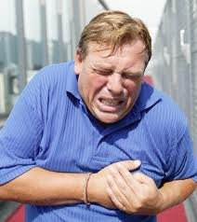
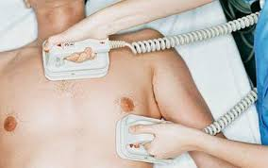
ایست قلبی-احیاrecovery

Slide 22
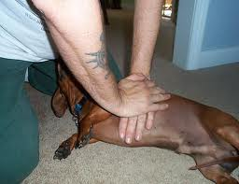
ایده چیست؟قوه تخیل مهمترازدانش است.

Slide 23
شرایط ثبت اختراع
subject matter must be accepted as "patentable" under law.
the invention must consist of patentable subject matter,
in order to be eligible for patent protection,
an invention must fall within the scope of
patentable subject matter. Patentable subject matter is established by statute, and is usually
defined in terms of the exceptions to patentability, the general rule being that patent protection
shall be available for inventions in all fields of technology (see Article 27.1 of the TRIPS Agreement).

Slide 24
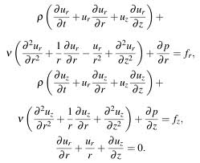
Exclusion from patentable subject matter
discoveries of materials or substances already existing in nature
scientific theories or mathematical methods;

Slide 25
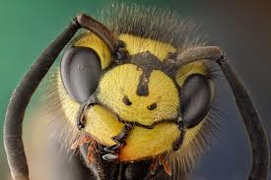
plants and animals other than microorganisms,

Slide 26
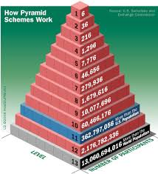
schemes, rules or methods,

Slide 27
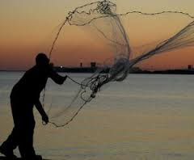
doing business, performing purely mental acts or playing games

Slide 28
methods of treatment for humans or animals,
Depression Treatments
Depression Medicines
Psychotherapy
Electric Shock Treatment
Interpersonal Therapy
Psychodynamic Therapy
Cognitive Behavioral درمان با شوک الکتریکی درمان بین فردی درمان روان پویشی درمان رفتاری شناختیTherapy

Slide 29
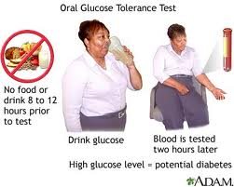
diagnostic methods practiced humans

Slide 30
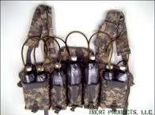
public order or morality

Slide 31
invention must be new (novel)
An invention is new if it is not anticipated by the prior art. “Prior art” is, in general, all the
knowledge that existed prior to the relevant filing or priority date of a patent application, whether it
existed by way of written or oral disclosure. The question of what should constitute “prior art” at a
given time is one which has been the subject of some debate.

Slide 32
The disclosure of an invention so that it becomes part of the prior art may take place in three ways ,
by a description of the invention in a published writing or publication in other form;
- by a description of the invention in spoken words uttered in public, such a disclosure being
called an oral disclosure;
- by the use of the invention in public, or by putting the public in a position that enables any
member of the public to use it, such a disclosure being a “disclosure by use

Slide 33
PUBLIC DOMAIN
Public knowledge - known to persons in the art. A part of the mental equipment of those concerned in the art under consideration
Common general knowledge: All available public knowledge and all that is published

Slide 34
Inventive Step (Non-Obviousness)
would have been obvious to a person having ordinary skill in the art;
The expression “ordinary skill” is intended to exclude the “best” expert that can be found.
It is intended that the person be limited to one having the average level of skill reached in the field
in the country concerned.

Slide 35
It should be noted that novelty and inventive step are different criteria.
Novelty exists if
there is any difference between the invention and the prior art.
The question, “is there inventive
step?” only arises if there is novelty. The expression “inventive step” conveys the idea that it is not
enough that the claimed invention is new, that is, different from what exists in the state of the art,
but that this difference must have two characteristics.
Firstly, it must be “inventive”, that is, the
result of a creative idea, and it must be a step, that is, it must be noticeable. There must be a
clearly identifiable difference between the state of the art and the claimed invention. This is why, in
some jurisdictions, there is the concept of an “advance” or “progress” over the prior art.

Slide 36
In order to assess the nature of the differences which are relied upon as constituting an
inventive step, account has to be taken of the prior art as a whole. Thus, as distinct from the
assessment of novelty, the subject matter of the claim under examination is compared not with
each publication or other disclosure separately, but with the combinations thereof, insofar as each
such combination is obvious to the person having ordinary skill in the art.

Slide 37
assess inventive step in relation to three aspects
the problem to be solved;
the solution to that problem;
the advantageous effects, if any, of the invention with reference to the background art.

Slide 38
Industrial Applicability (Utility)
should be possible to make that product.
t he invention is intended to be a
process or part of a process, it should be possible to carry that process out or “use” it .(the general term) in practice
possibility of making and manufacturing in practice,

Slide 39
Disclosure of the Invention
The application must disclose the invention in a manner sufficiently clear for the invention
to be carried out by a person skilled in the art.
The description should set out at least one mode for carrying out the invention claimed.

Slide 40
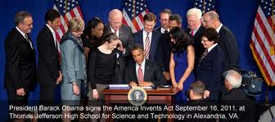
زمان ایجاد حق اختراع
first to file patent
First to invent

Slide 41
اصل وحدت اختراع

Slide 42
اقسام اظهارنامه اختراع وحمایت
1-ملی
2-منطقه ای
3-بین المللی
اصل سرزمینی بودن اختراع

Slide 43
اتحادیه منطقه ای
African Regional Intellectual Property Organization
Botswana Gambia Ghana Kenya Lesotho Liberia Malawi Mozambique Namibia Rwanda Sierra Leone Somalia Sudan Swaziland Tanzania Uganda Zambia Zimbabwe

Slide 44
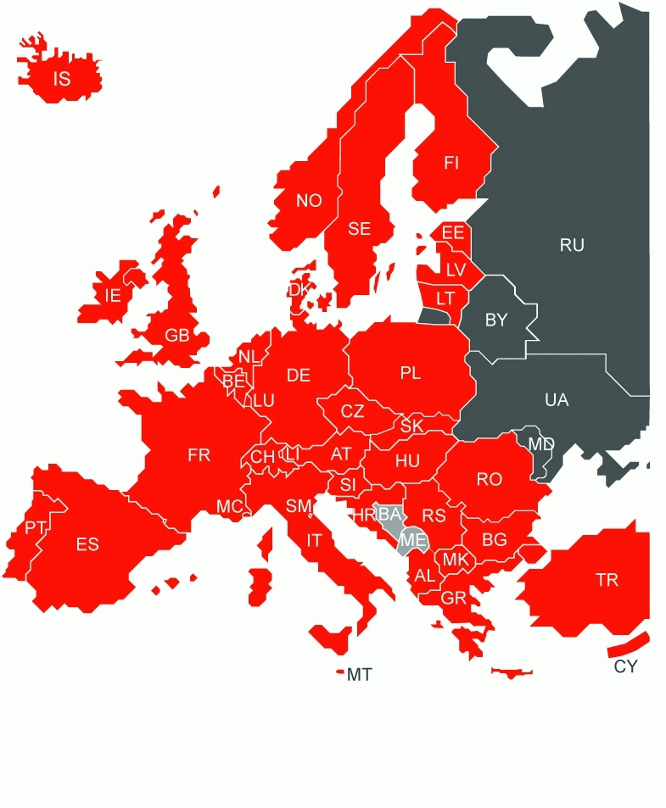
European Patent Organisation

Slide 45
EURASIAN PATENT OFFICE (EAPO)
There are 8 member states: Turkmenistan, the Republic of Belarus, the Republic of Tajikistan, Russia, the Azerbaijan Republic, the Republic of Kazakhstan, Kyrgyzstan, and the Republic of Armenia. The Republic of Moldova is a former member state. On 26 October 2011, the Republic of Moldova denounced the Eurasian Patent Convention, meaning that, since 26 April 2012, it is no longer party to the Convention.^{[1]} In the meantime, in December 2011, negotiations on a "validation and co-operation agreement" between the European Patent Office (EPO) and the Republic of Moldova were authorized by the Administrative Council of the European Patent Organisation

Slide 46
AFRICAN INTELLECTUAL PROPERTY ORGANIZATION (OAPI)
BF Burkina Faso BJ Benin CF Central African Republic CG Congo CI Côte d’Ivoire CM Cameroon GA Gabon GN Guinea GQ Equatorial Guinea GW Guinea-Bissau KM Comoros⁷ ML Mali MR Mauritania NE Niger SN Senegal TD Chad TG Togo

Slide 47
Gulf Cooperation Council (GCC)
The GCC Patent Office (GCCPO) is a regional patent office based in Riyadh, Saudi Arabia, within the Secretariat General of the Gulf Cooperation Council (GCC). It was established in 1992 and began operations in 1998. The GCC Patent Office grants patents valid in all GCC member states. The first GCC patent was granted in 2002. As of 2013, it employed about 30 patent examiners.

